Slide 1
Coefficient of coupling

Slide 2
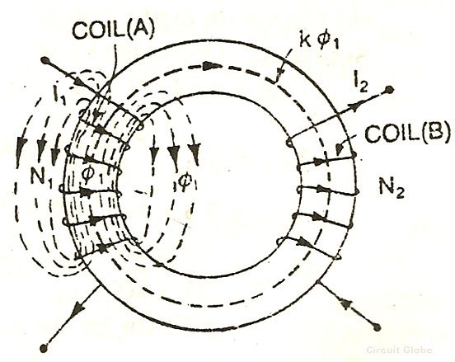
The fraction of magnetic flux produced by the current in one coil that links with the other coil is called the coefficient of coupling between the two coils. It is denoted by (k).
The amount of coupling between the inductively coupled coils is expressed in terms of the coefficient of coupling
Two coils are taken coil A and coil B, when current flows through one coil it produces flux; the whole flux may not link with the other coil coupled, and this is because of leakage flux by a fraction (k) known as Coefficient Of Coupling

Slide 3
k=1, when the flux produced by one coil, completely links with the other coil and is called magnetically tightly coupled.
k=0, when the flux produced by one coil, does not link at all with the other coil and thus the coils are said to be magnetically isolated.

Slide 4


DERIVATION
Consider two magnetic coils A and B.When current I₁ flows through coil A.
Considering coil B in which current I₂ flows

Slide 5
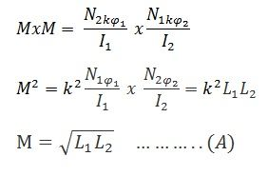
Multiplying equation (1) and (2)
The above equation (A) shows the relationship between mutual inductance and self-inductance between the two coils

